Slide 1

UNIVERSITY INSTITUTE OF ENGINEERING
COMPUTER SCIENCE ENGINEERING
Machine Learning
23CSH-651
By Dr. Meena Pundir
INTRODUCTION
DISCOVER . LEARN . EMPOWER

Slide 2
Regression
For classification the output(s) is nominal
In regression the output is continuous
Function Approximation
Many models could be used – Simplest is linear regression
Fit data with the best hyper-plane which "goes through" the points
y
dependent
variable
(output)
x – independent variable (input)

Slide 3
Regression
For classification the output(s) is nominal
In regression the output is continuous
Function Approximation
Many models could be used – Simplest is linear regression
Fit data with the best hyper-plane which "goes through" the points
y
dependent
variable
(output)
x – independent variable (input)
Notes:
Show generalization

Slide 4
Regression
For classification the output(s) is nominal
In regression the output is continuous
Function Approximation
Many models could be used – Simplest is linear regression
Fit data with the best hyper-plane which "goes through" the points
For each point the difference between the predicted point and the actual observation is the residue
y
x
Notes:
Non-linear regression models later
linear regression like perceptron for classification

Slide 5
Simple Linear Regression
For now, assume just one (input) independent variable x, and one (output) dependent variable y
Multiple linear regression assumes an input vector x
Multivariate linear regression assumes an output vector y
We "fit" the points with a line (i.e. hyperplane)
Which line should we use?
Choose an objective function
For simple linear regression we use sum squared error (SSE)
Σ (predicted_{i} – actual_{i})² = Σ (residue_{i})²
Thus, find the line which minimizes the sum of the squared residues (e.g. least squares)
This exactly mimics the case assuming data points were sampled from an actual target hyperplane with Gaussian noise added
Notes:
Hyperplane for multiple linear regression

Slide 6
How do we "learn" parameters
For the 2-d problem (line) there are coefficients for the bias and the independent variable (y-intercept and slope)
To find the values for the coefficients (weights) which minimize the objective function we can take the partial derivates of the objective function (SSE) with respect to the coefficients. Set these to 0, and solve.
Notes:
Betas are weight/coefficients

Slide 7
Multiple Linear Regression
There is a closed form for finding multiple linear regression weights which requires matrix inversion, etc.
There are also iterative techniques to find weights
One is the delta rule. For regression we use an output node which is not thresholded (just does a linear sum) and iteratively apply the delta rule – For regression net is the output
Where c is the learning rate and x_{i} is the input for that weight
Delta rule will update until minimizing the SSE, thus solving multiple linear regression
There are other regression approaches that give different results by trying to better handle outliers and other statistical anomalies
Notes:
Note target really is the point being regressed to each time. Now makes better sense since net is the output and we want to minimize error of the target.

Slide 8
SSE and Linear Regression
SSE squares the difference of the predicted vs actual
Don't want residues to cancel each other
Could use absolute or other distances to solve problem
Σ |predicted_{i} – actual_{i}| : L1 vs L2
SSE leads to a parabolic error surface which is great for gradient descent
Which line would least squares choose?
There is always one “best” fit with SSE (L2)
An L1 error can have multiple best fits
Notes:
Would choose middle 9+9 < 49

Slide 9
SSE and Linear Regression
SSE leads to a parabolic error surface which is great for gradient descent
Which line would least squares choose?
There is always one “best” fit
7
Notes:
Show error for each line. 49
Not Euclidean distance to line, but just in the input dimension(s) as shown

Slide 10
SSE and Linear Regression
SSE leads to a parabolic error surface which is great for gradient descent
Which line would least squares choose?
There is always one “best” fit
7
5

Slide 11
SSE and Linear Regression
SSE leads to a parabolic error surface which is great for gradient descent
Which line would least squares choose?
There is always one “best” fit
Note that the squared error causes the model to be more highly influenced by outliers
But is the best fit assuming Gaussian noise error from true target
7
3
5
3
Notes:
Would choose middle 9+9 < 49
NOW TRY L1 error (absolute value), different results (which are not as good), multiple lines with minimal error

Slide 12
SSE and Linear Regression Generalization
In generalization all x values map to a y value on the chosen regression line
7
5
3
3
y – Input Value
1
0 1 2 3
x – Input Value
Notes:
Would choose middle 9+9 < 49
NOW TRY absolute value, less good results, multiple tied best lines, etc.

Slide 13
Linear Regression - Challenge Question
Assume we start with all weights as 1 (don’t use bias weight though you usually always will – else forces the line through the origin)
Remember for regression we use an output node which is not thresholded (just does a linear sum) and iteratively apply the delta rule – thus the net is the output
What are the new weights after one iteration through the following training set using the delta rule with a learning rate c = 1
How does it generalize for the novel input (-.3, 0)?
After one epoch the weight vector is:
1 .5
1.35 .94
1.35 .86
.4 .86
None of the above
x₁ | x₂ | Target y
.5 | -.2 | 1
1 | 0 | -.4

Slide 14
Linear Regression - Challenge Question
Assume we start with all weights as 1
What are the new weights after one iteration through the training set using the delta rule with a learning rate c = 1
How does it generalize for the novel input (-.3, 0)?
x₁ | x₂ | Target | Net | w₁ | w₂
 |  |  |  | 1 | 1
.5 | -.2 | 1
1 | 0 | -.4
w₁ = 1 +

Slide 15
Linear Regression - Challenge Question
Assume we start with all weights as 1
What are the new weights after one iteration through the training set using the delta rule with a learning rate c = 1
How does it generalize for the novel input (-.3, 0)?
-.3*-.4 + 0*.86 = .12
x₁ | x₂ | Target | Net | w₁ | w₂
 |  |  |  | 1 | 1
.5 | -.2 | 1 | .3 | 1.35 | .86
1 | 0 | -.4 | 1.35 | -.4 | .86
w₁ = 1 + 1(1 – .3).5 = 1.35

Slide 16
Linear Regression Homework
Assume we start with all weights as 0 (Include the bias!)
What are the new weights after one iteration through the following training set using the delta rule with a learning rate c = .2
How does it generalize for the novel input (1, .5)?
x₁ | x₂ | Target
.3 | .8 | .7
-.3 | 1.6 | -.1
.9 | 0 | 1.3

Slide 17
Intelligibility (Interpretable ML, Transparent)
One advantage of linear regression models (and linear classification) is the potential to look at the weights to give insight into which input variables are most important in predicting the output
The variables with the largest weight magnitudes have the highest correlation with the output
A large positive weight implies that the output will increase when this input is increased (positively correlated)
A large negative weight implies that the output will decrease when this input is increased (negatively correlated)
A small or 0 weight suggests that the input is uncorrelated with the output (at least at the 1st order)
Linear regression/classification can be used to find best "indicators"
Be careful not to confuse correlation with causality
Linear models cannot detect higher order correlations! The power of more complex machine learning models!!
Notes:
Dependent (output) variable rain. Independent (input) variable: Clouds, umbrella open, etc. Open-Umbrella is correlate, not causal.
Humans are already pretty good at finding lower order combinations.

Slide 18
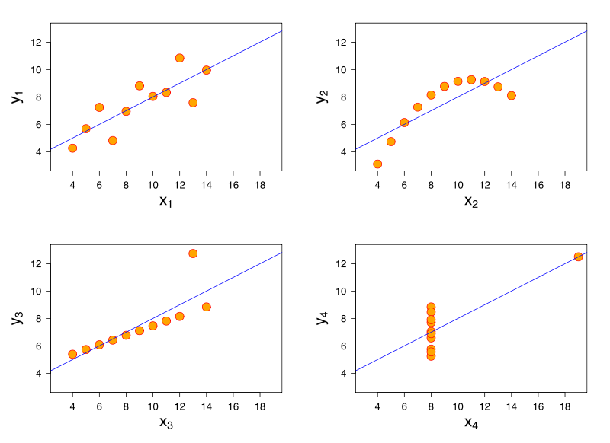
Anscombe's Quartet
What lines "really" best fit each case? – different approaches
Notes:
Standard LR gives same line for each
If Gaussian error is #4 likely?, But in actual data set with human error, etc.?
Some approaches fit bottom two, but which is best? Noise vs exception

Slide 19
Anscombe's Quartet
What lines "really" best fit each case? – different approaches
Notes:
Standard LR gives same line for each
If Gaussian error is #4 likely?, But in actual data set with human error, etc.?
Some approaches fit bottom two, but which is best? Noise vs exception

